Slide 1
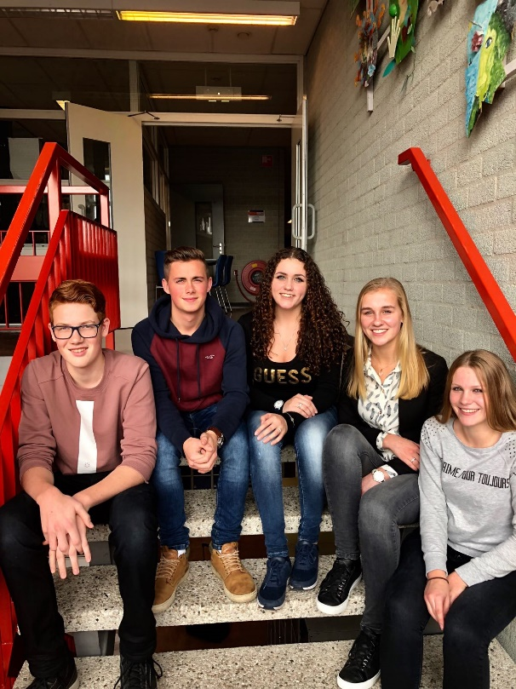
Introduction
3tt1
Wes, Sanne, Bente, Lauren & Kris

Slide 2
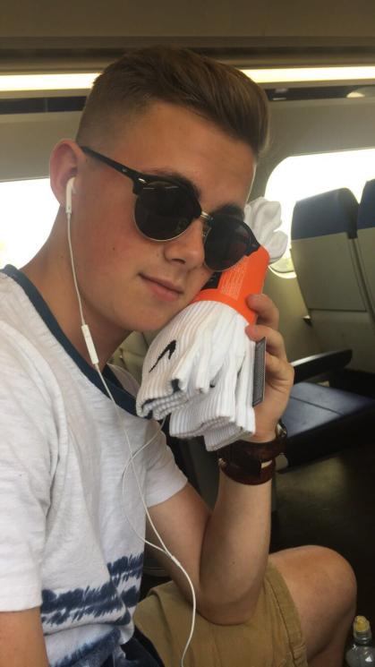
Wes :
Hello, I'm Wes, a 16 year old boy who lives in the south of The Netherlands. I enjoy playing soccer and gaming in my free time.

Slide 3
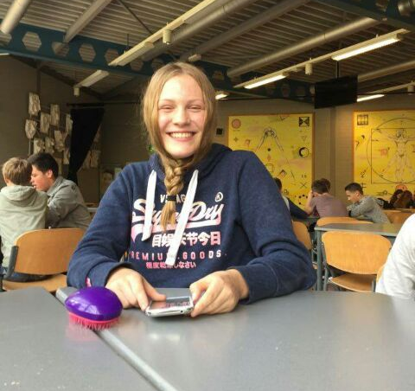
Sanne
Hallo, I'm Sanne, I am 14 years old and I live in Netersel. My hobbies are korfball and dancing.

Slide 4
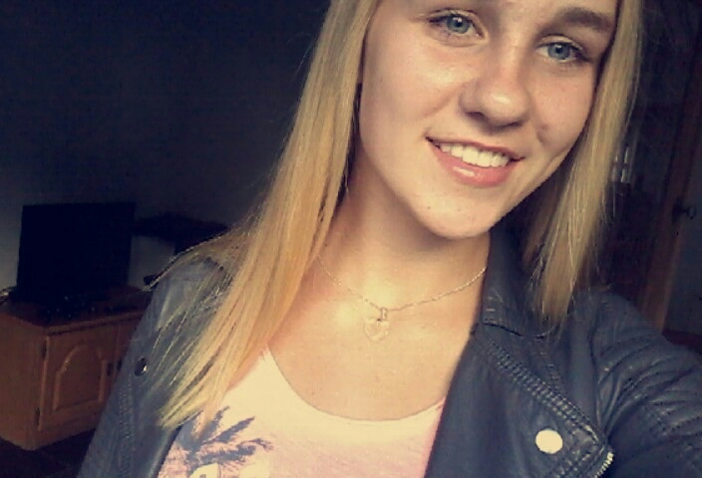
Bente
Hello, I'm Bente, I'm 14 years old and I live in Netersel, in the south of The Netherlands. My hobbies are korfball, dancing and playing the saxophone.

Slide 5
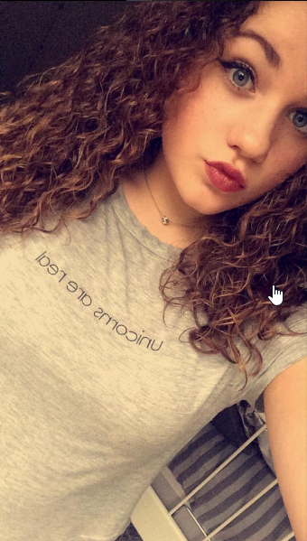
Lauren
Hi, I’m Lauren, I’m 15 years of age and I live in Bladel.
In my spare time I like to ride my horse.

Slide 6
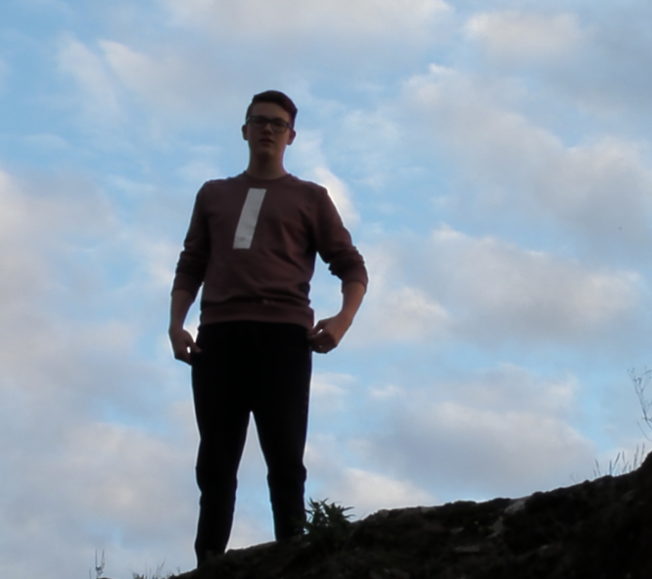
Kris
Hay, I'm Kris, I'm 15 years old and I live in Bladel a village in the south of The Netherlands. I like to work out and play video games.

